Slide 1
Project 1
DATE
24/06/2024
Multimodal Egocentric Action Recognition
Festa Shabani (s317640), Giacomo Fantino (s310624), Farisan Fekri (s308066)
Teaching Assistants: Gabriele Goletto
Simone Alberto Peirone

Slide 2
Multimodal Egocentric Action Recognition
ActionNet
Epic-Kitchens
Datasets

Slide 3
Multimodal Egocentric Action Recognition
Objective Analysis
01
Egocentric Vision:
Captures user activities and interactions from a first-person perspective using wearable cameras.
02
Project Goal:
Apply multimodal learning to egocentric action recognition, starting with RGB visual streams and integrating ElectroMyoGraphy (EMG) signals.
03
Methodology:
Employ Variational Autoencoders (VAEs) to generate EMG signals from RGB frames, enhancing action recognition accuracy.
04
Impact:
Integrating EMG through cross-modal data generation improves the robustness of action recognition systems.

Slide 4
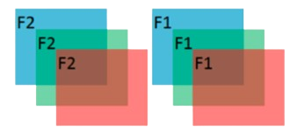
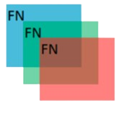
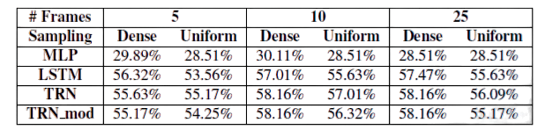
RGB
Feature Extraction using I3D
Number of clips: 5.
Training: Pretrained on Kinetics or further finetuned on Epic-Kitchens.
Sampling Strategy: Dense or Uniform Sampling.
Frames per Clip: 5, 10, 25.
Classifiers
Temporal Relational Reasoning Network (TRN)
Multi-Layer Perceptron (MLP)
Long Short-Term Memory (LSTM)

Slide 5
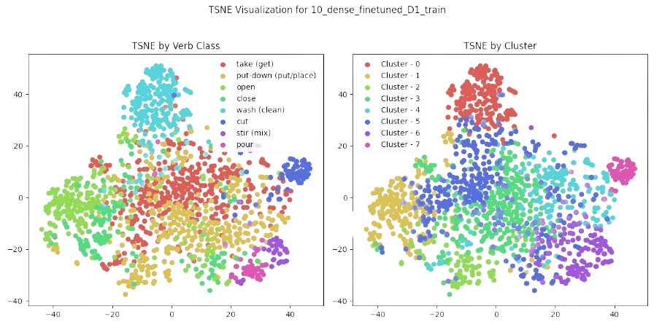
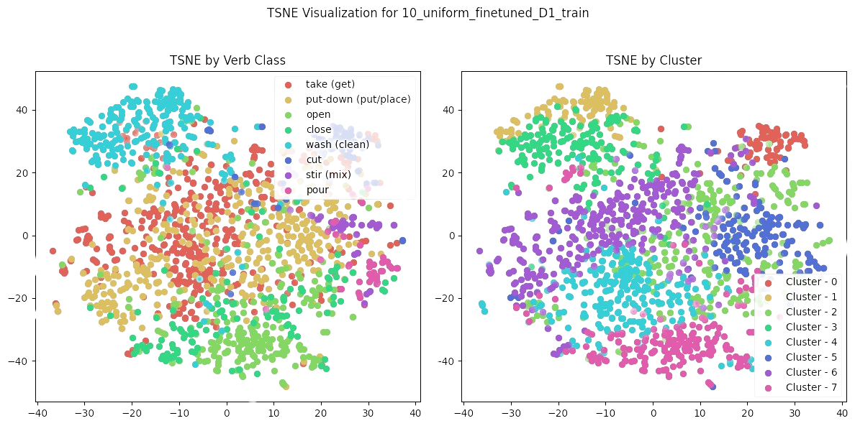
Multimodal Egocentric Action Recognition
Visualization and clustering of RGB features

Slide 6
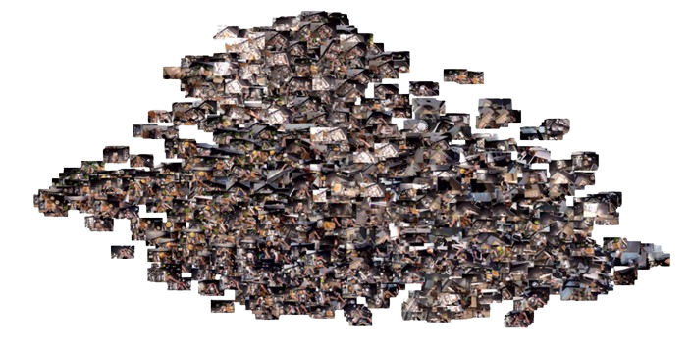
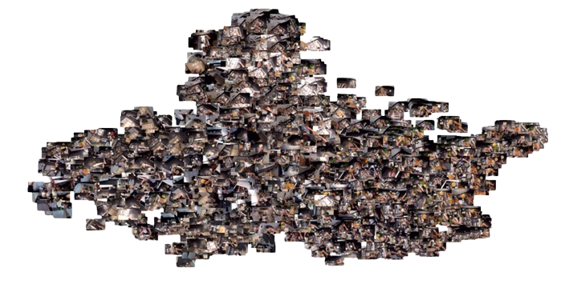
Multimodal Egocentric Action Recognition
10 frames per clip and dense sampling
10 frames per clip and uniform sampling
Visualization and clustering of RGB features using central frames

Slide 7
Multimodal Egocentric Action Recognition
RGB
Feature Extraction using I3D
Number of clips: 5.
Training: Pretrained on Kinetics or further finetuned on Epic-Kitchens.
Sampling Strategy: Dense or Uniform Sampling.
Frames per Clip: 5, 10, 25.
Classifiers
Temporal Relational Reasoning Network (TRN)
Multi-Layer Perceptron (MLP)
Long Short-Term Memory (LSTM)

Slide 8
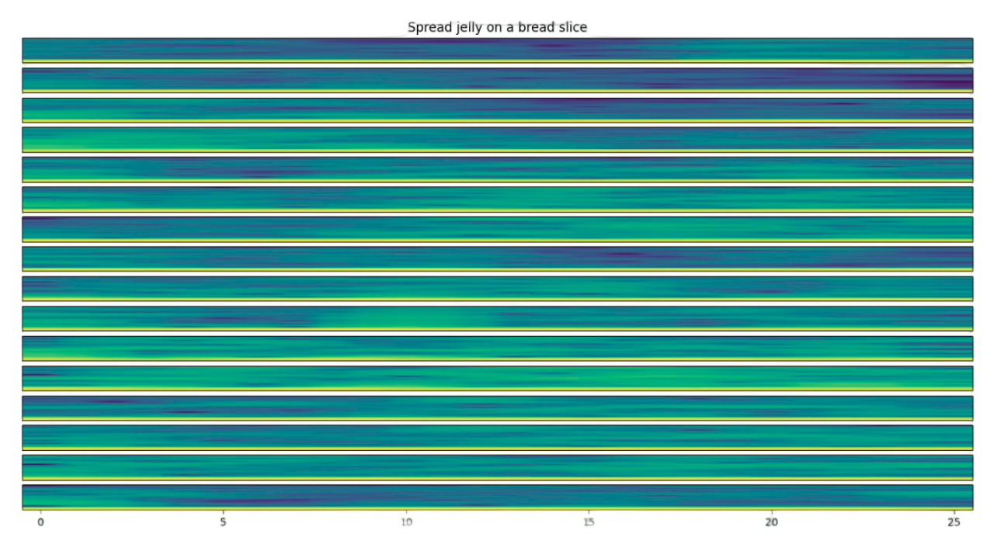
Multimodal Egocentric Action Recognition
EMG (Electromyography)
Preprocessing
Rectification: Convert each signal to its absolute value.
Low-pass Filtering: 5 Hz
Normalization: Range [-1, 1].
Downsampling: From 160 Hz to 10 Hz.
Augmentation: Split actions into 10-second subactions.
Conversion to Spectrograms: For time-frequency feature extraction.
Convolutional Neural Network Architecture
Feature Extraction: Capture spatiotemporal hierarchies in EMG spectrograms.
Classification: Model outputs logits and feature vectors.
Spectrogram demonstrating muscle activity for both forearms

Slide 9
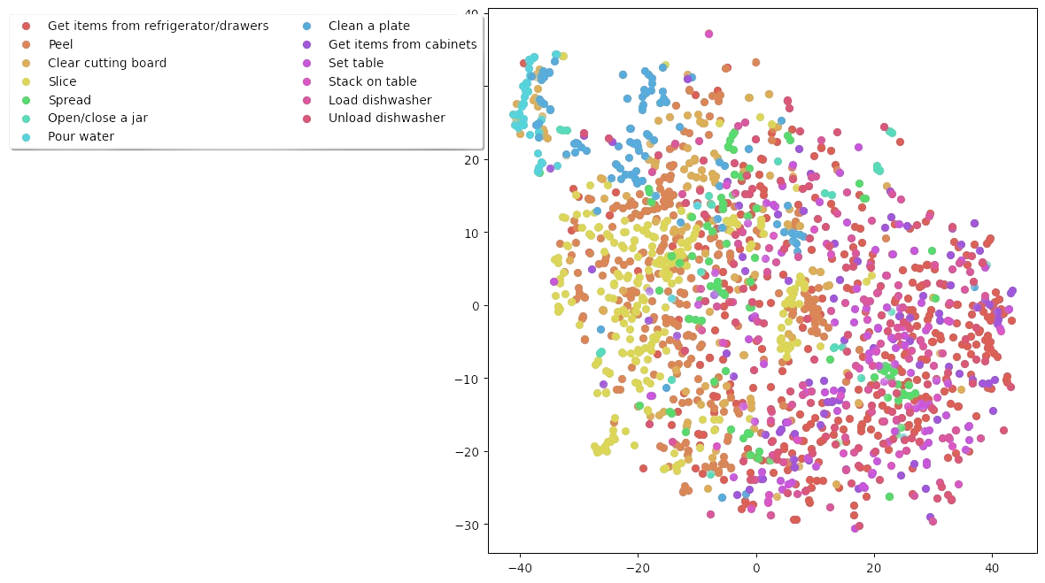
Multimodal Egocentric Action Recognition
EMG Plotting Visualization

Slide 10
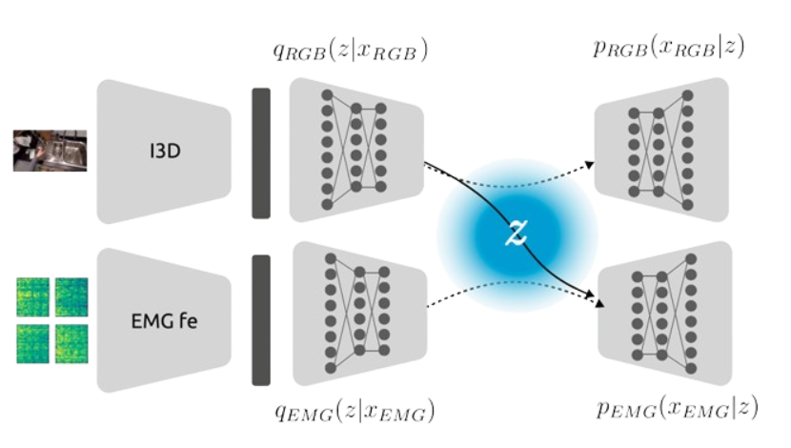
Multimodal Egocentric Action Recognition
Visual2Signals - Cross Modality Translation
Variational Autoencoder for RGB
Reconstructs RGB frames from Epic-Kitchens features
Variational Autoencoder for EMG
Reconstructs EMG signals from ActionNet features
Hybrid Variational Autoencoder for Subject S04 in ActionNet
Combines RGB encoder and EMG decoder for cross-modal
learning on ActionNet's subject S04

Slide 11
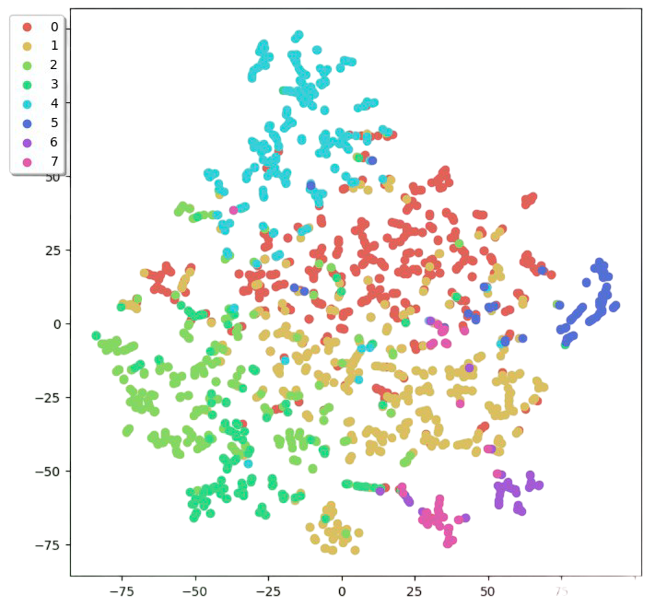
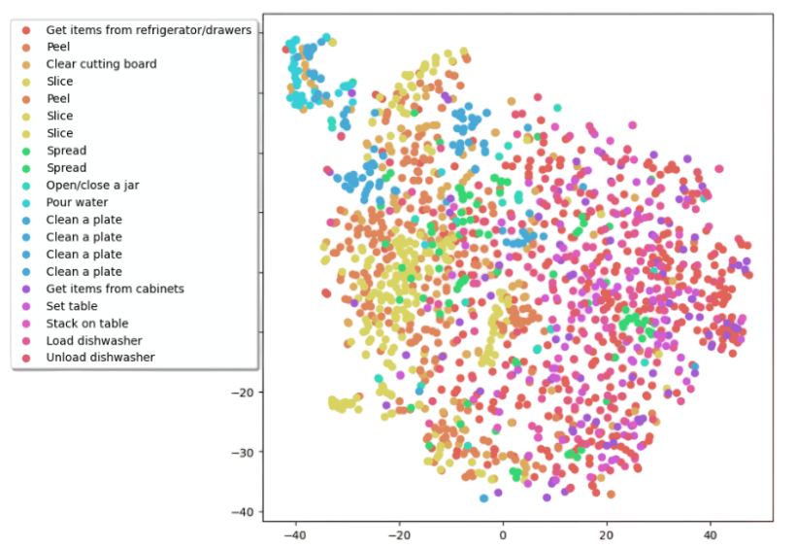
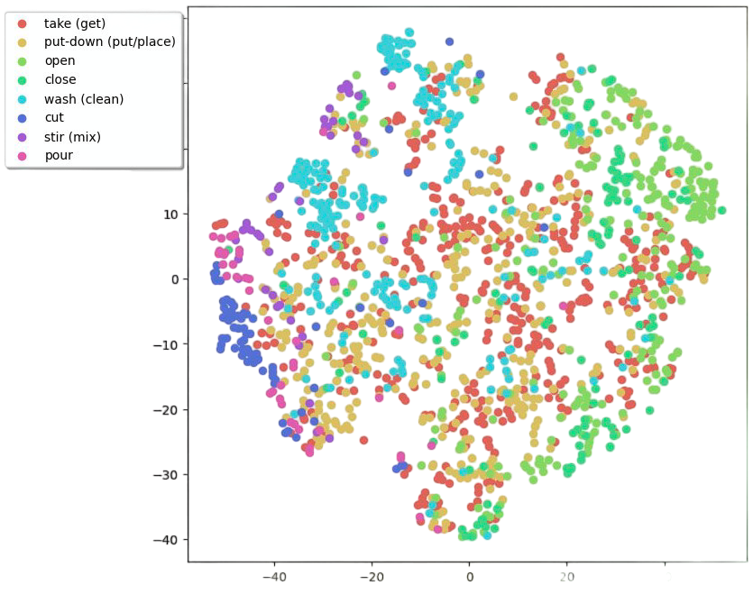
Multimodal Egocentric Action Recognition
Comparative Variational Autoencoder Analysis
Reconstructed RGB features
Reconstructed EMG features
Synthetic EMG data for EK

Slide 12
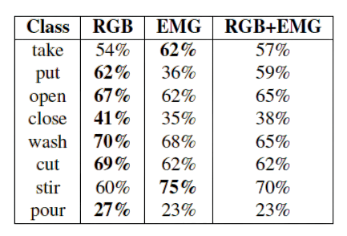
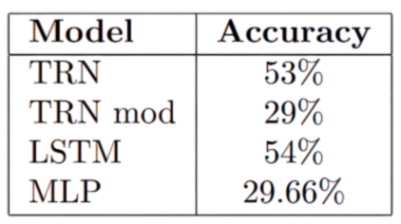
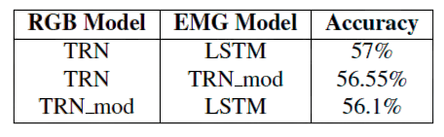
Multimodal Egocentric Action Recognition
Qualitative Results and Multimodal Accuracy
Synthetic EMG data of EK with the EMG only modality
Best-performing multimodal accuracy
Results for different classes

Slide 13
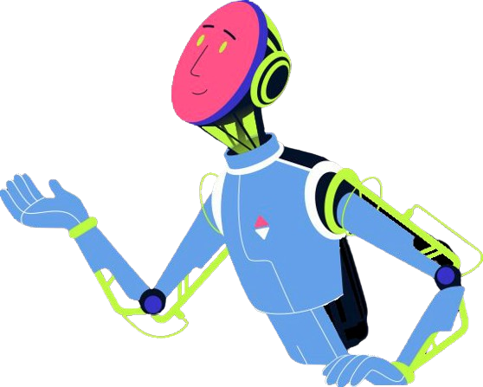
Multimodal Egocentric Action Recognition
Conclusion
Our study demonstrated the successful synthesis of missing EMG data using VAEs, effectively bridging gaps between different data modalities and aiming to enhance multimodal egocentric action recognition.
Translating modalities maintained comparable accuracy to original data, validating robustness.
Future research should refine fusion techniques and explore new modalities for broader application in action recognition.

